Slide 1
Energy Consumption Optimization
Domain: Smart Building Management / Sustainable Energy Systems
Technical Stack: Python, Random Forest Regression, Scikit-learn
Presented By: Preet Pansuriya

Slide 2
Executive Summary
Objective: To develop a predictive model that forecasts energy demand and identifies optimization opportunities to reduce carbon footprint and operational costs.
Core Approach: Utilizing historical meter data to recognize consumption patterns and implementing an automated alert system for peak-load management.
Outcome: Improved energy efficiency through data-driven insights.

Slide 3
Problem Statement
Energy Inefficiency: Commercial buildings often consume excessive power during non-operational hours (Idle Load).
Lack of Foresight: Without accurate forecasting, facility managers cannot plan for peak demand, leading to high utility "demand charges.“
Solution: A Machine Learning (ML) framework that predicts hourly consumption to enable proactive energy saving.

Slide 4

Dataset Architecture (Office_Abbey)
Data Source: Part of the "Building Data Genome Project" (Kaggle).
Temporal Resolution: Hourly energy meter readings.
Primary Variables:
Timestamp: Temporal index for time-series analysis.
Meter_Reading: Energy consumption (KW/kWh).
Significance: Represents a real-world commercial office environment with distinct occupancy-driven load profiles.

Slide 5
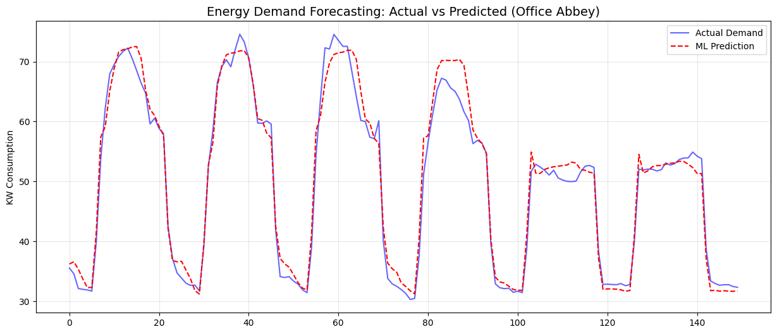
Methodology & Workflow
Exploratory Data Analysis (EDA): Identifying seasonal trends and weekly seasonality (Workdays vs. Weekends).
Data Imputation: Applying Linear Interpolation to handle missing sensor data.
Feature Engineering: * Cyclic Time Features (Hour of the day, Day of the week).
Binary Indicators (Is_Weekend, Holiday flag).
Model Training: Implementing Random Forest Regressor to capture non-linear energy consumption behaviors.

Slide 6
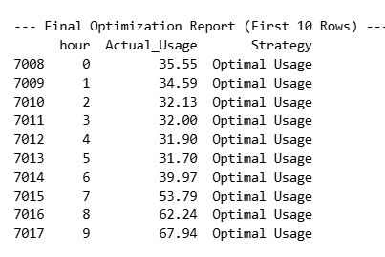
Feature Engineering Strategy
Why Hour? Captures the daily cycle of lighting and HVAC systems.
Why Day of Week? Differentiates between high-intensity weekdays and low-intensity weekend maintenance loads.
Rolling Statistics: (Optional Mention) Moving averages to capture short-term energy trends.

Slide 7
Predictive Modeling & Evaluation
Algorithm: Random Forest Ensemble (100 Decision Trees).
Training Strategy: Time-series split (Sequential) to prevent "data leakage.“
Performance Metrics:
RMSE (Root Mean Squared Error): Quantifying the deviation from actual readings.
R² Score: Measures how well the model explains the variance in consumption.

Slide 8
Optimization & Strategic Recommendations
Peak Load Shaving: Shifting heavy operations to off-peak hours based on predicted spikes.
Anomaly Detection: Real-time monitoring; if Actual Usage >> Predicted Usage, the system triggers an maintenance alert.
HVAC Scheduling: Optimizing heating/cooling start times based on predicted occupancy hours.

Slide 9
Future Roadmap
Hyper-local Weather Integration: Incorporating Temperature and Humidity data to model HVAC sensitivity.
Real-time Dashboard: Developing a Streamlit or Flask interface for facility managers.
Advanced Architectures: Implementing LSTM (Long Short-Term Memory) networks for enhanced temporal forecasting.

Slide 10
Conclusion
The project successfully demonstrates that Machine Learning can transform raw meter data into actionable energy-saving strategies.
Final Impact: Potential reduction in building energy waste by 15-20% through smart forecasting and optimized scheduling.

Slide 11
THANK YOU

